Slide 1
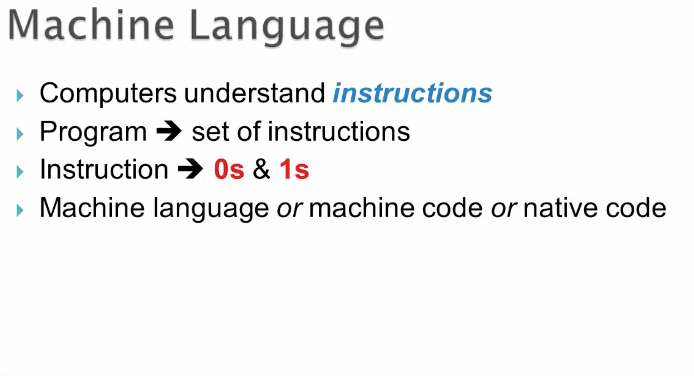

Slide 2
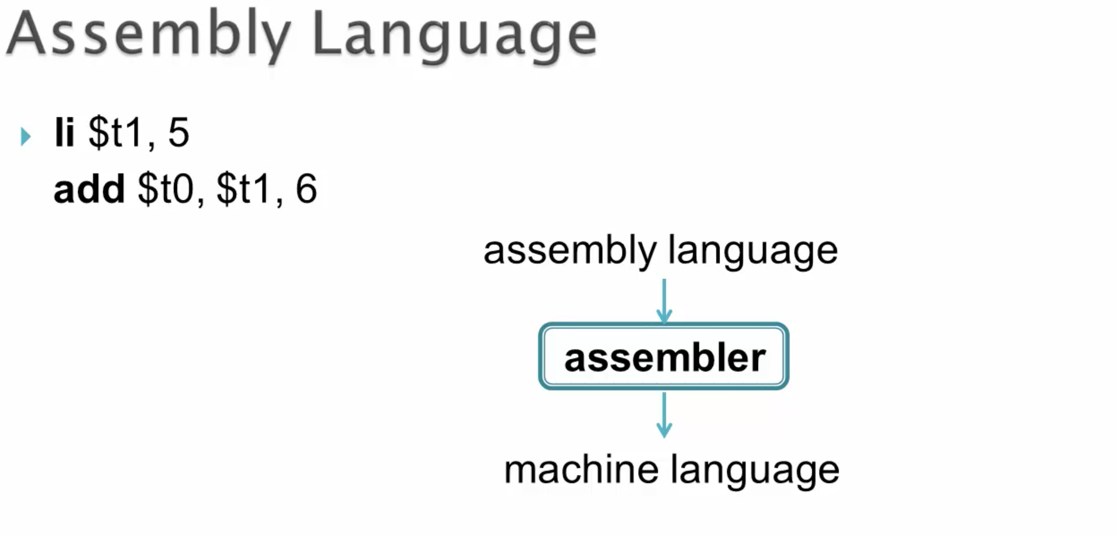

Slide 3
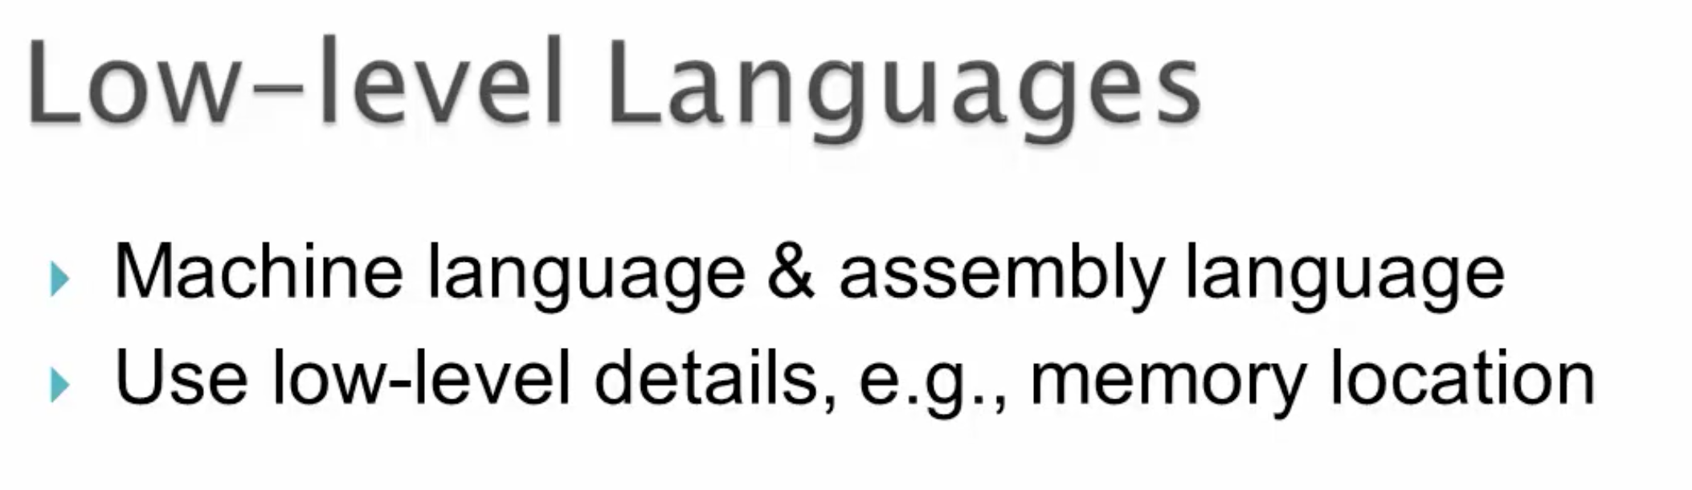
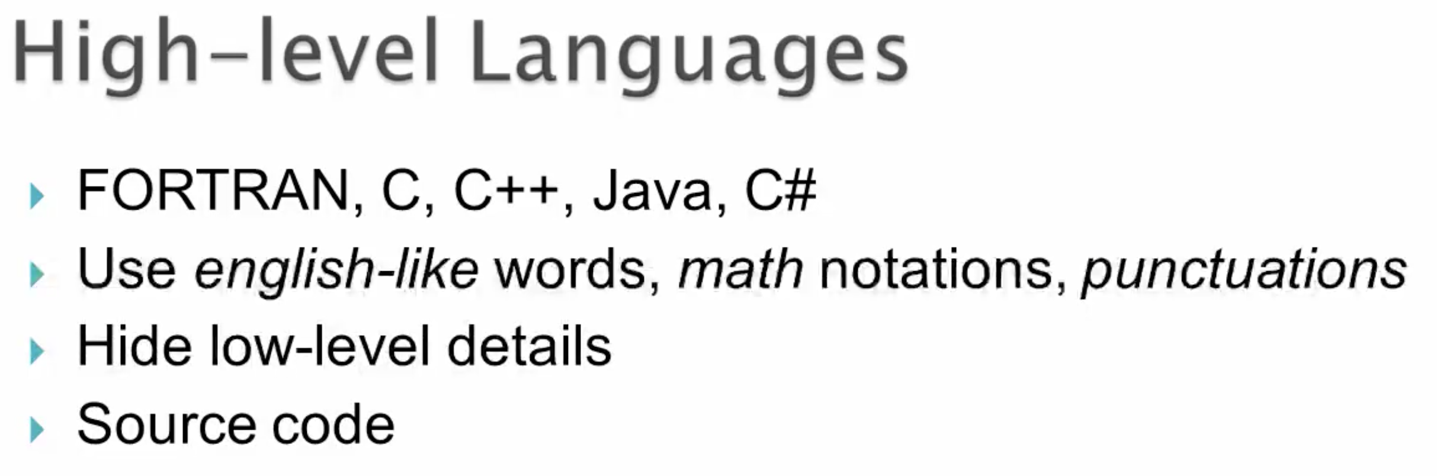

Slide 4
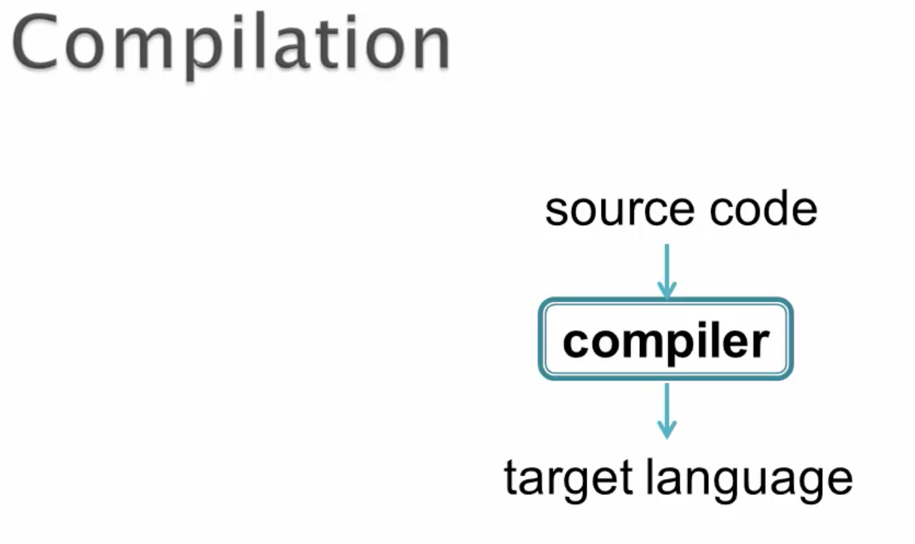
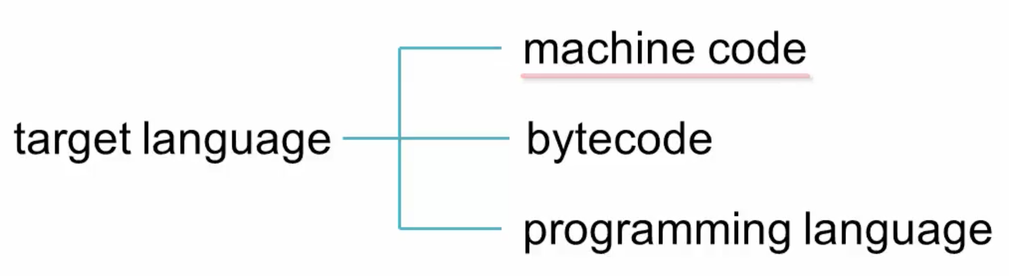

Slide 5
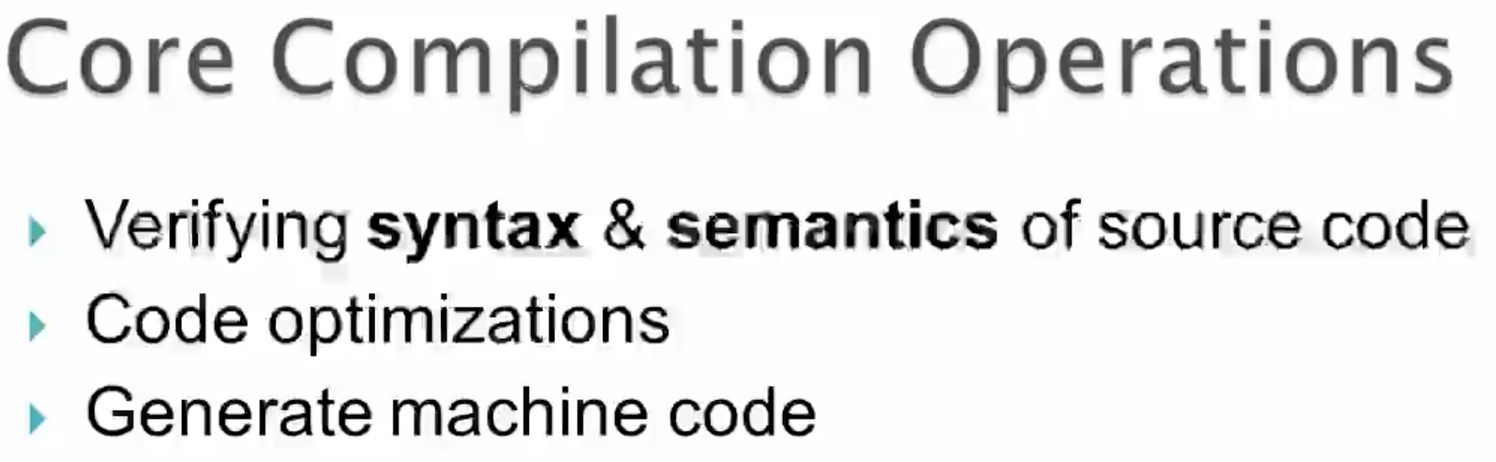

Slide 6
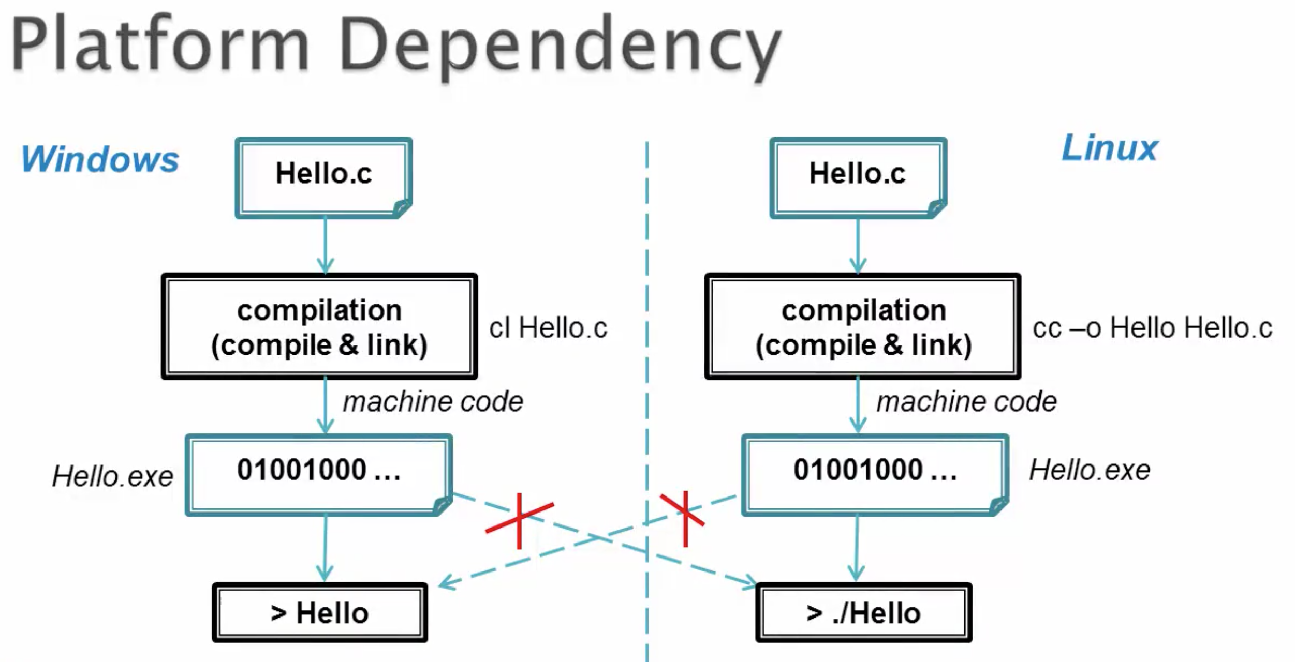

Slide 7
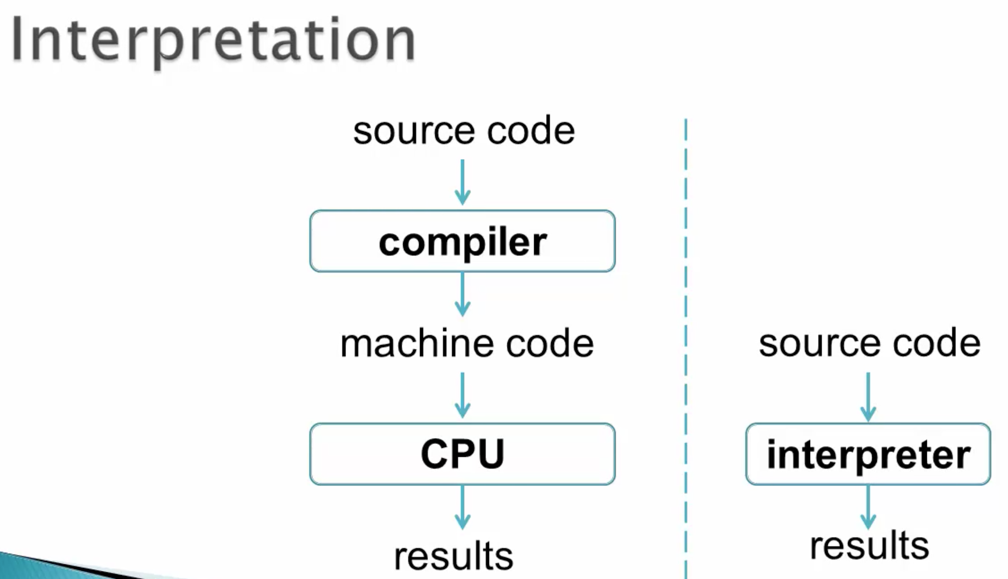


Slide 8
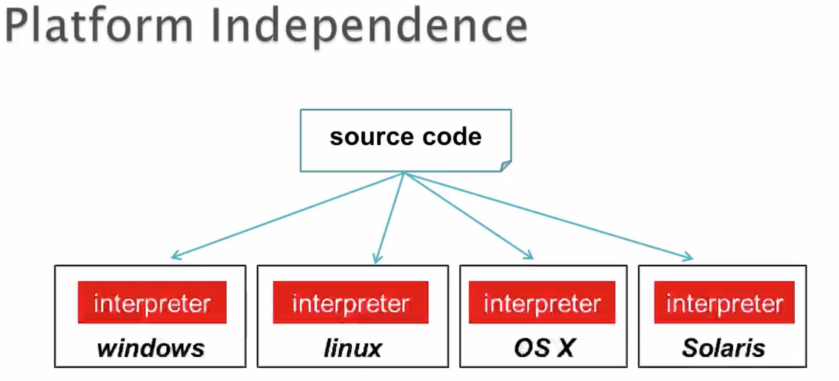

Slide 9
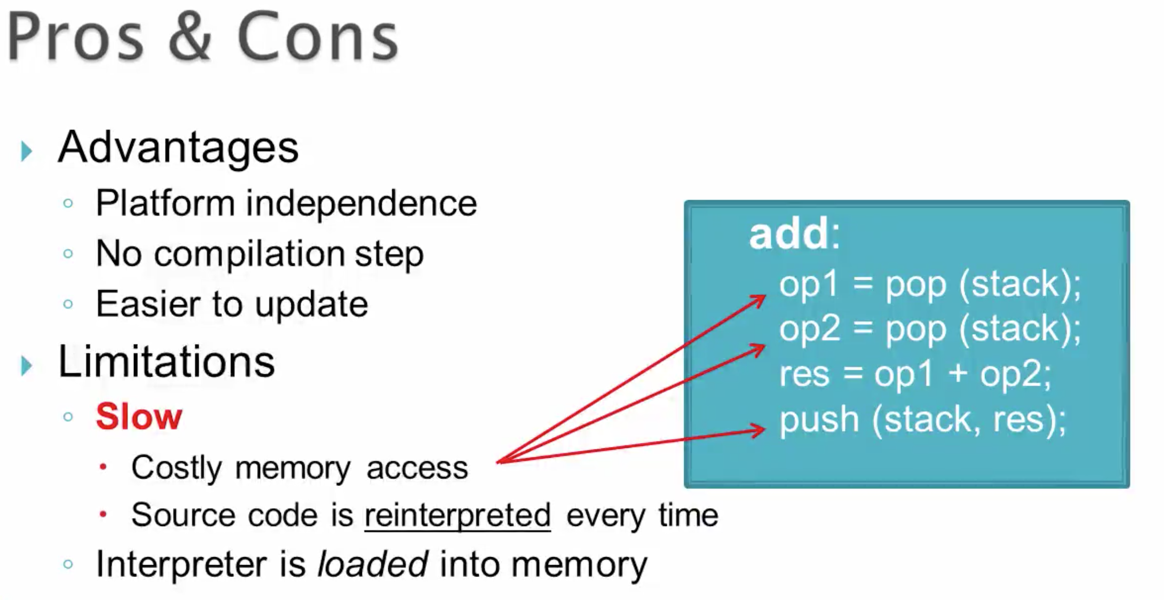

Slide 10
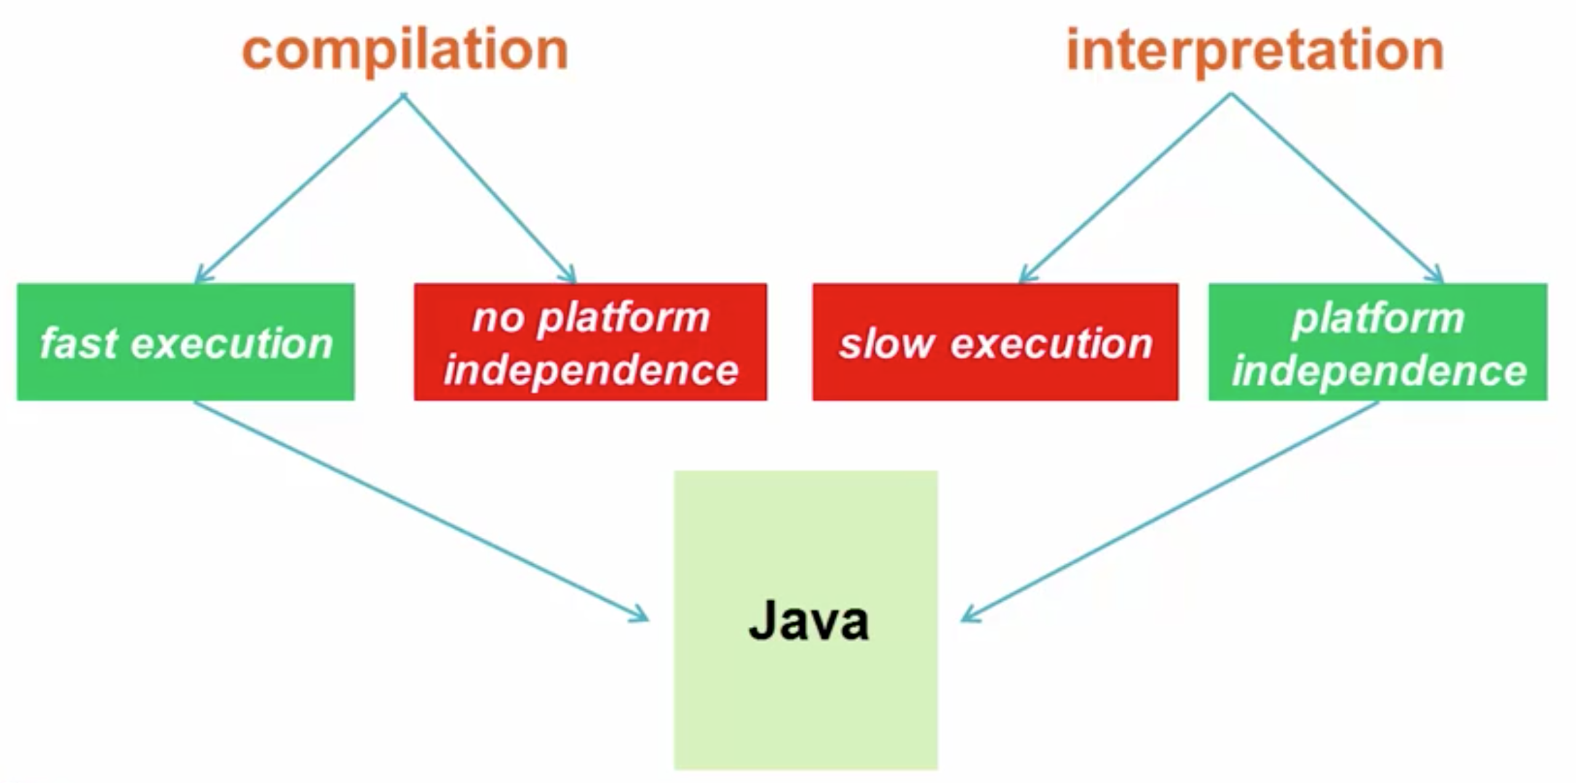

Slide 11
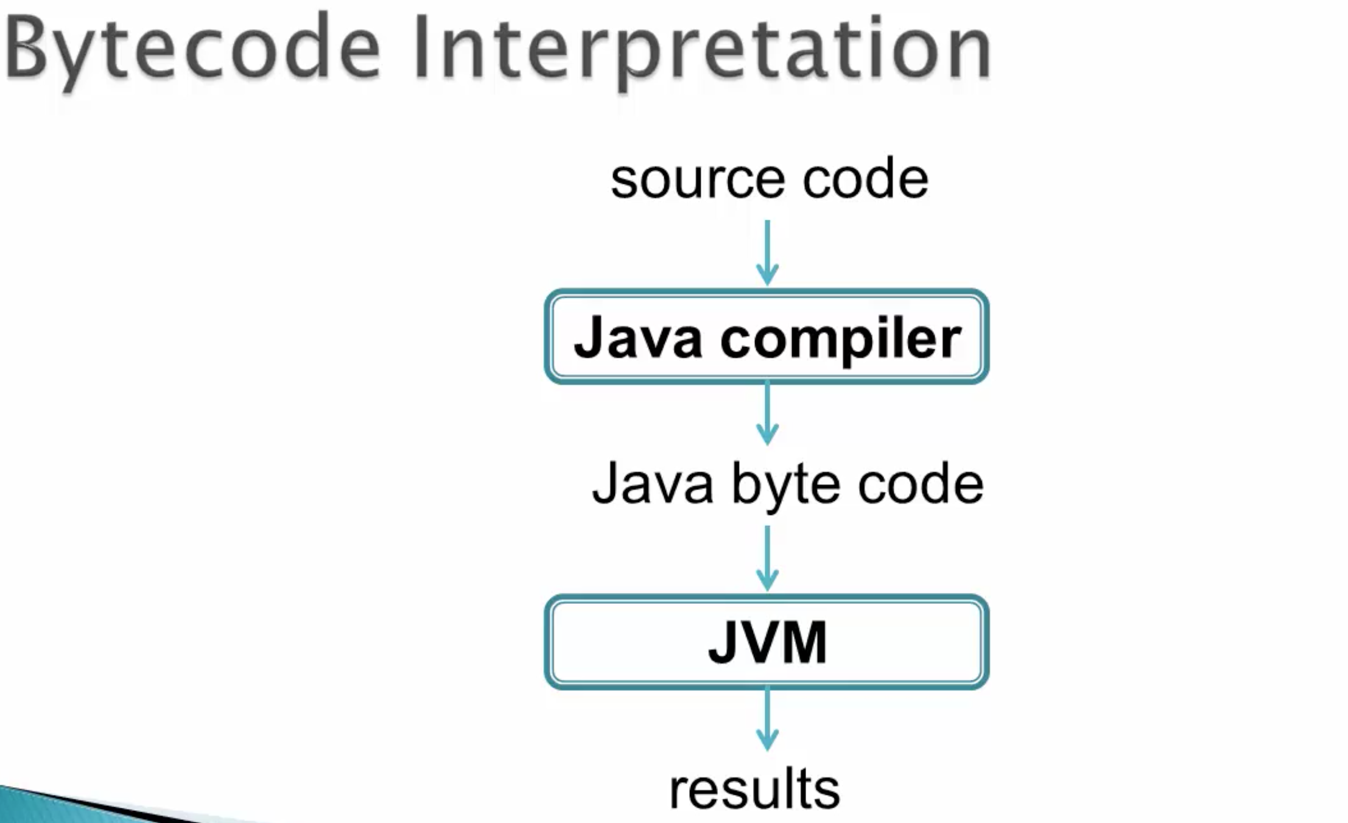


Slide 12
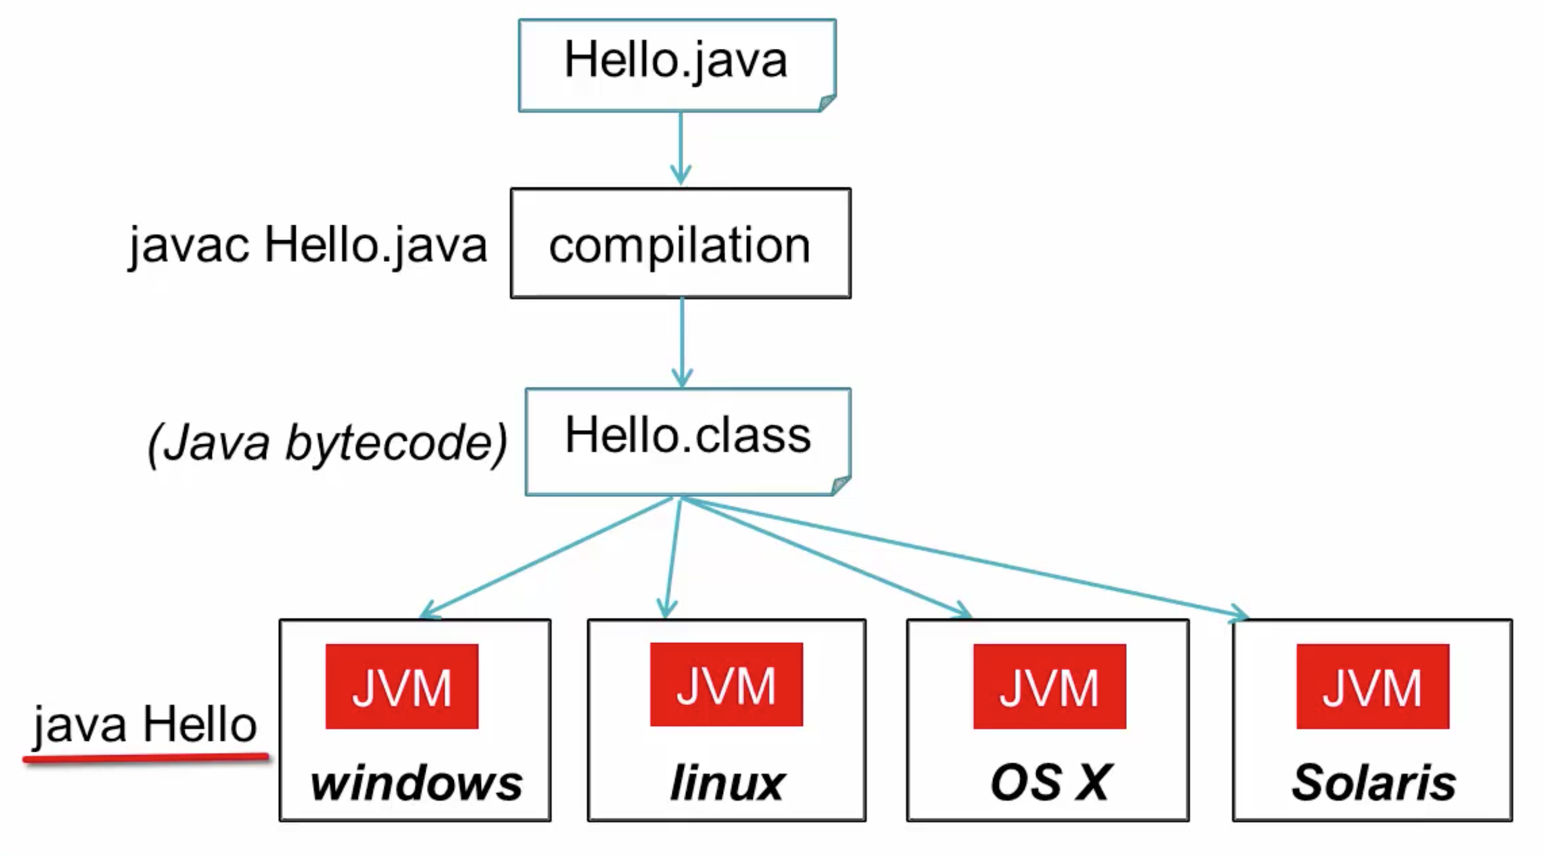

Slide 13
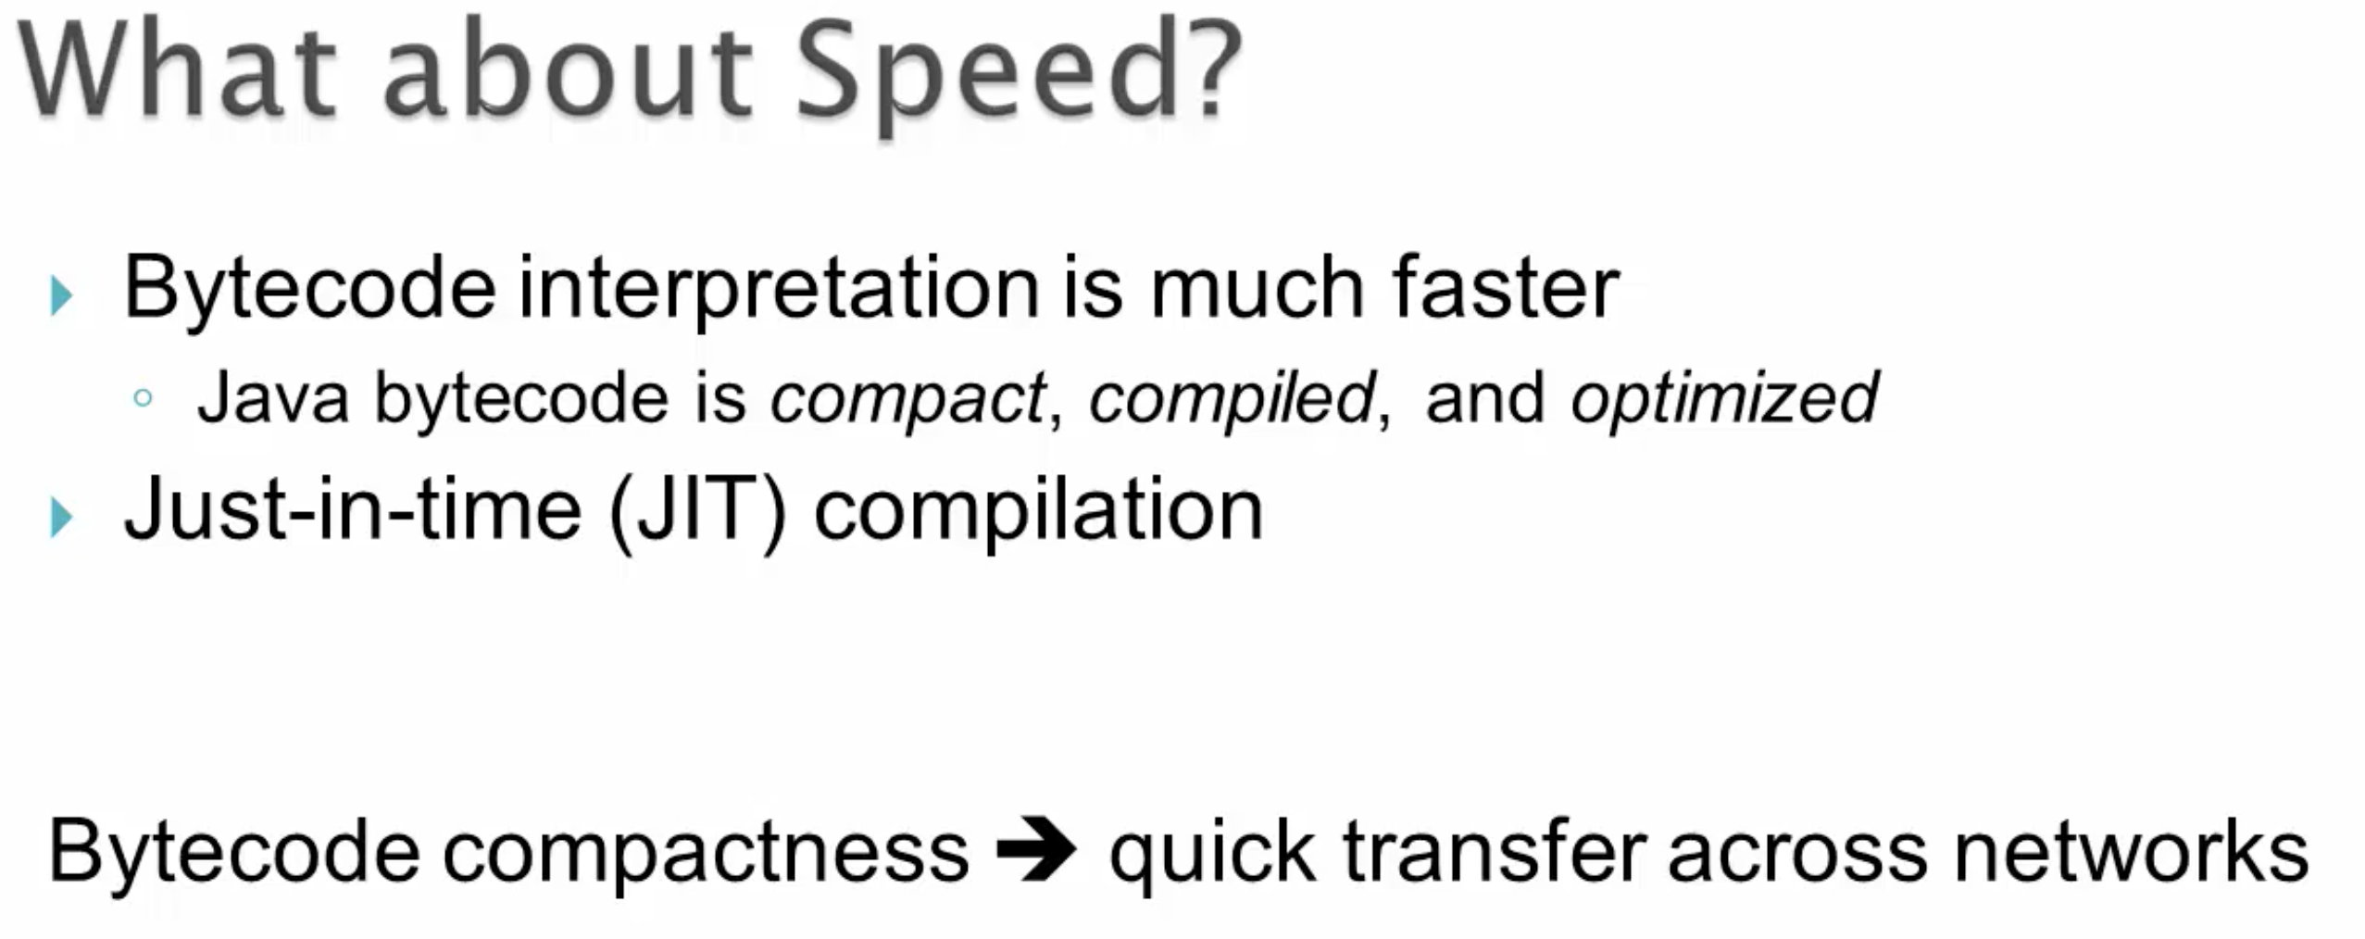

Slide 14
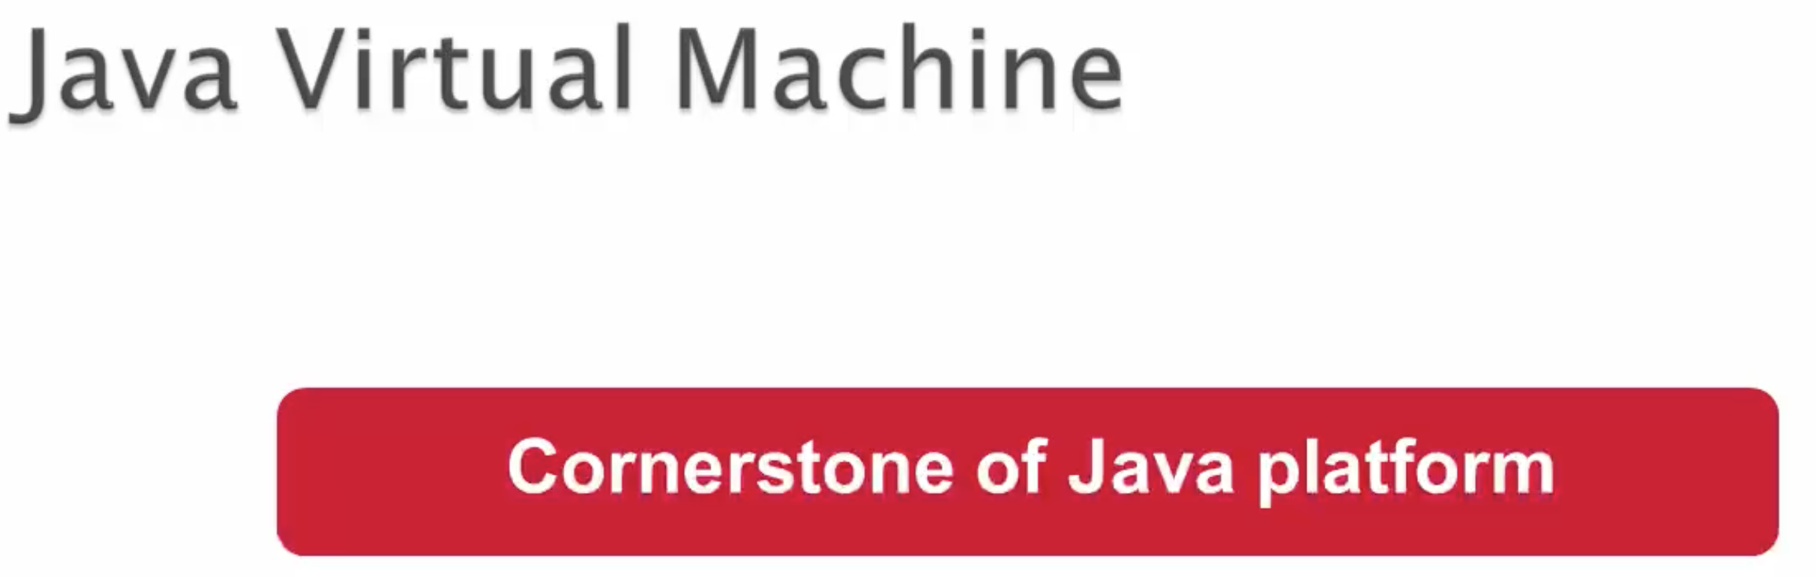

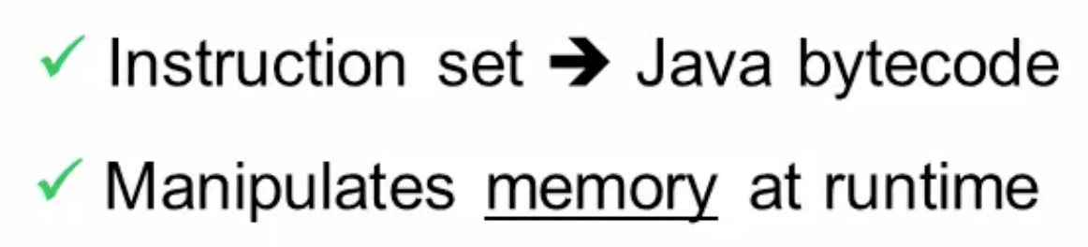

Slide 15
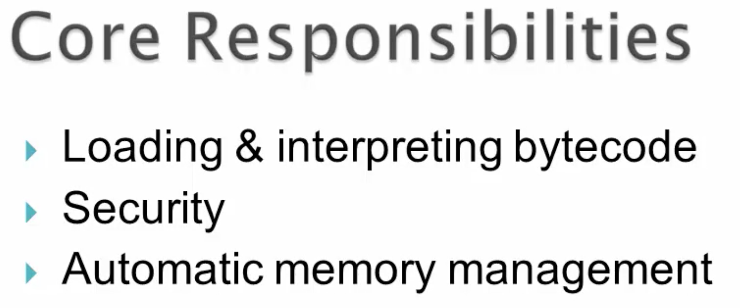
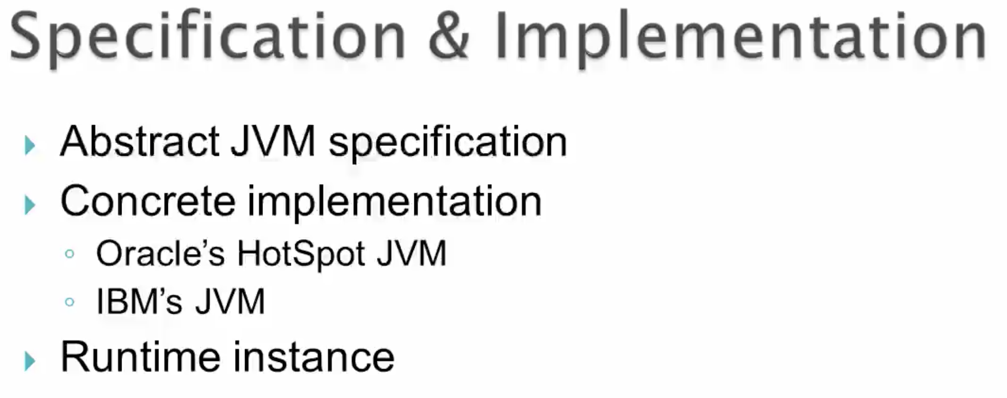

Slide 16
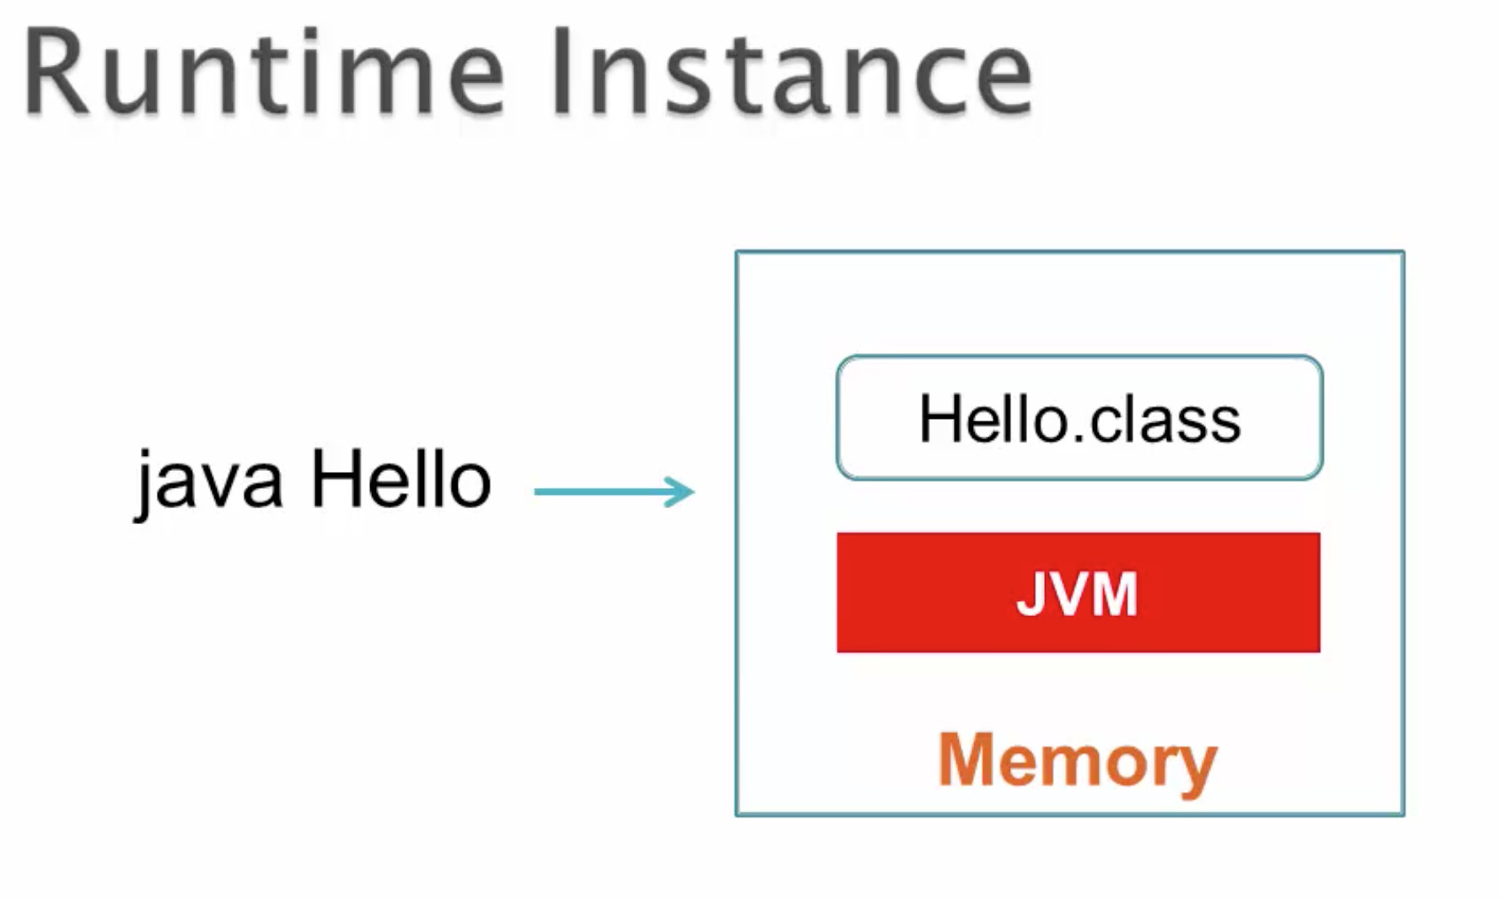

Slide 17
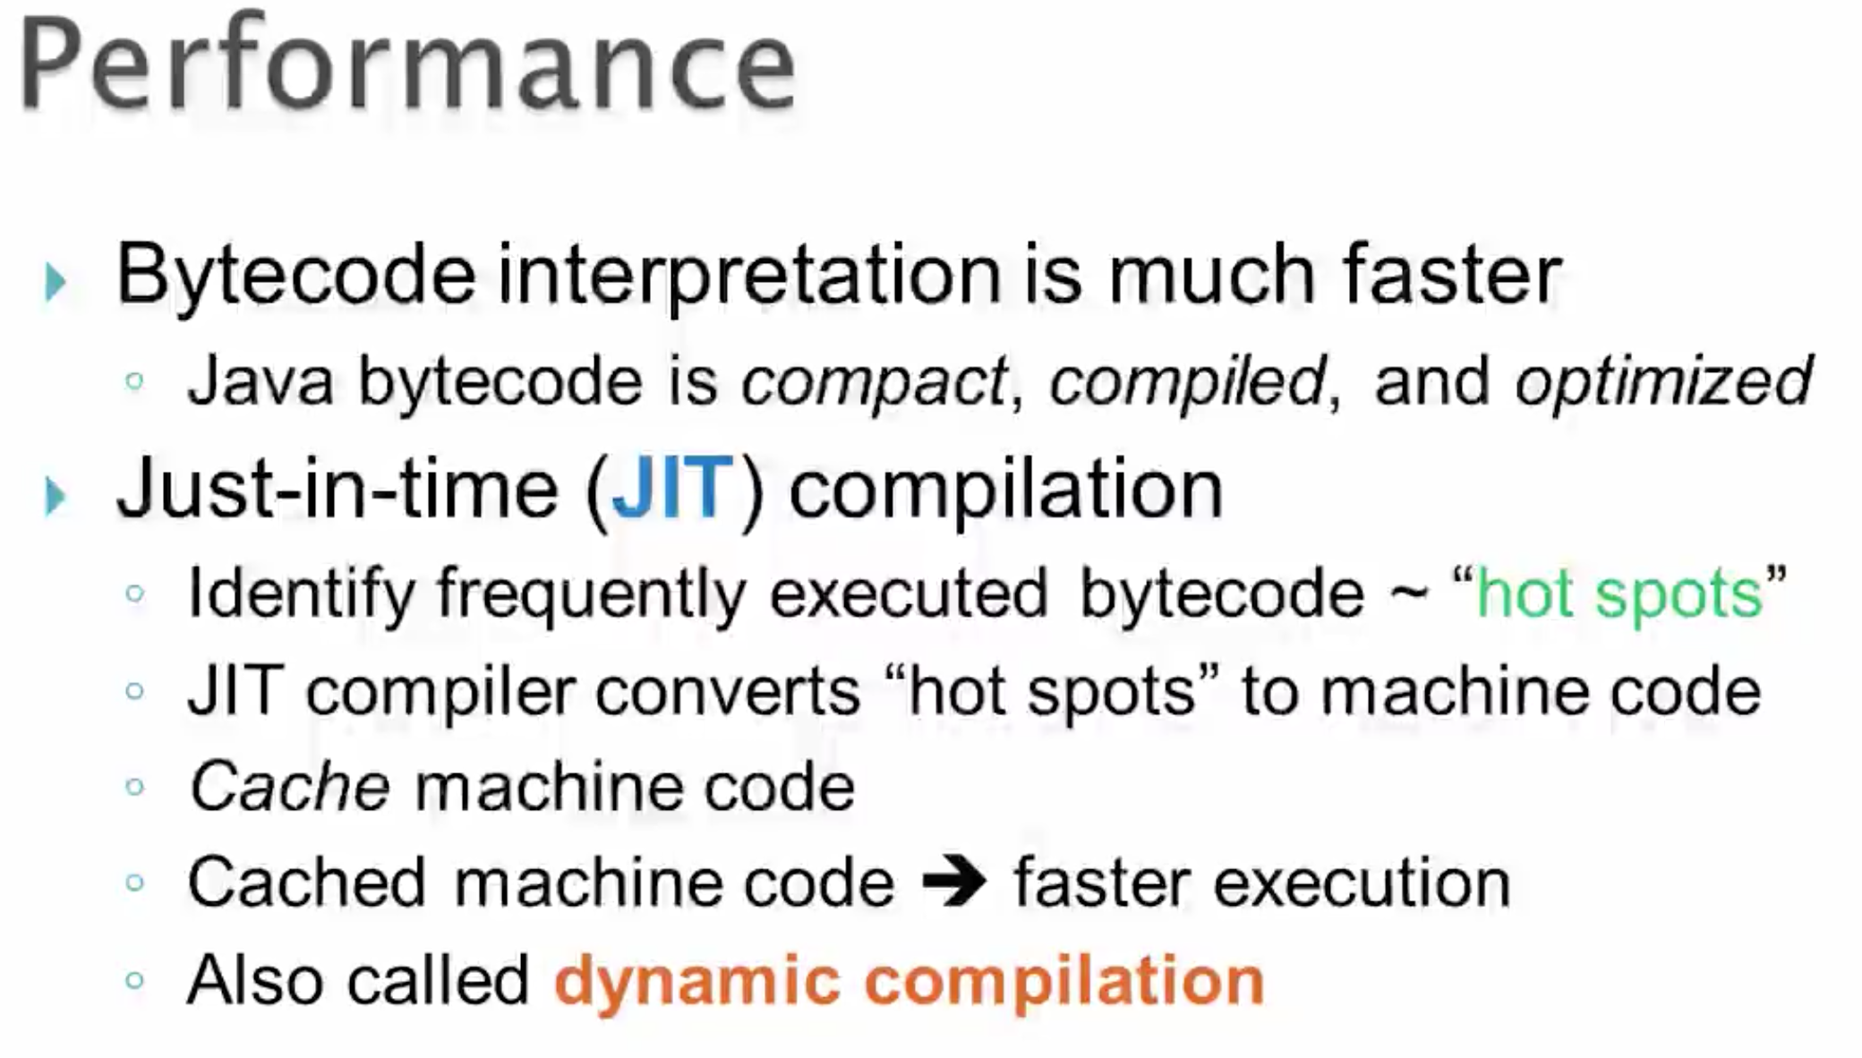

Slide 18
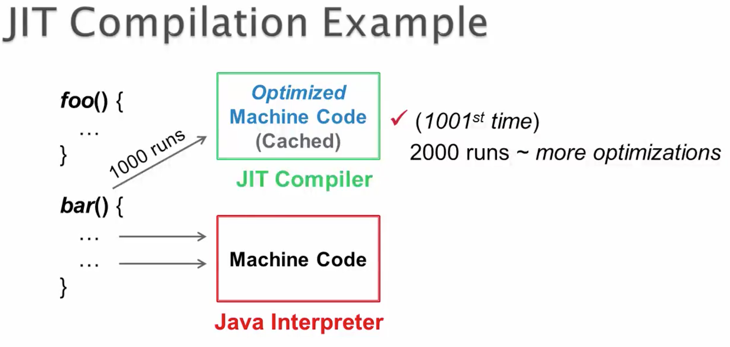

Slide 19
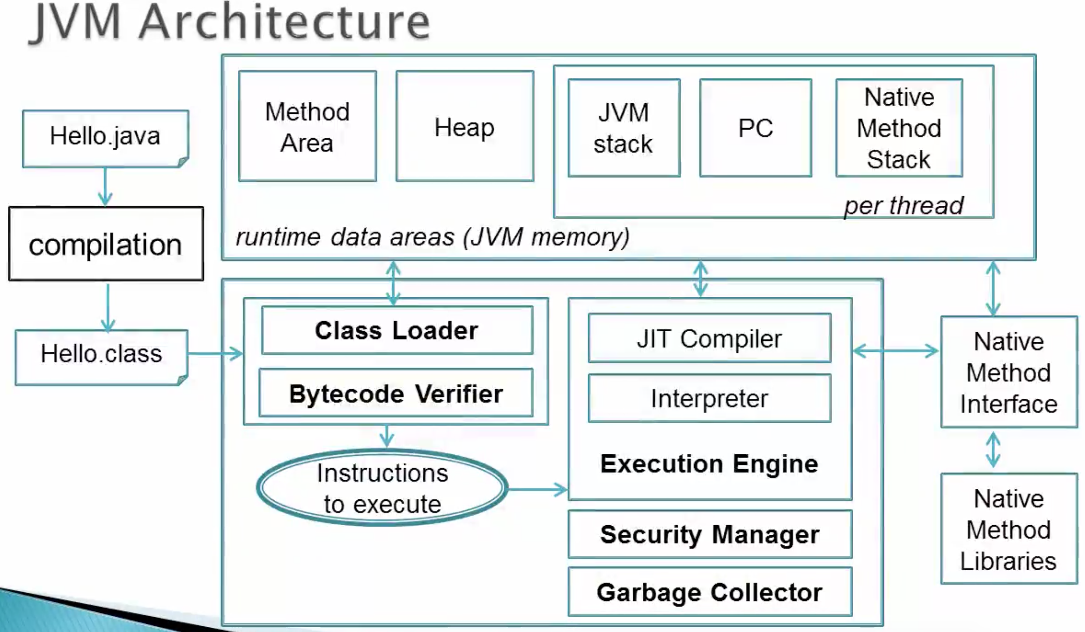


Slide 20
Below are some useful references pertaining to JIT compiler. They mainly explain whatever is described in the lecture with regards to JIT compiler. So, if you are interested you may check them out too.
http://stackoverflow.com/questions/3718024/jit-vs-interpreters ~ KGhatak's answer is excellent in that it explains the difference between Java's normal interpretation & JIT's compilation. Both generatemachine code, but JIT's version is optimized. Moreover, a method of block of code that is JIT compiledwill not be reinterpreted and will directly use the cached JIT generated machine code
Check out Paul Pacheco's answer https://www.quora.com/If-a-JIT-compiler-compiles-the-bytecode-into-machinecode-what-is-the-interpreter-doing-Does-it-simply-run-the-machine-code-Do-JITand-the-interpreter-work-in-parallel
Checkout Vicky Singh's answer https://www.quora.com/In-Java-what-exactly-will-the-JVM-interpreter-and-theJIT-compiler-do-with-the-bytecode
http://stackoverflow.com/questions/2377273/how-does-an-interpretercompiler-work?lq=1

Slide 21
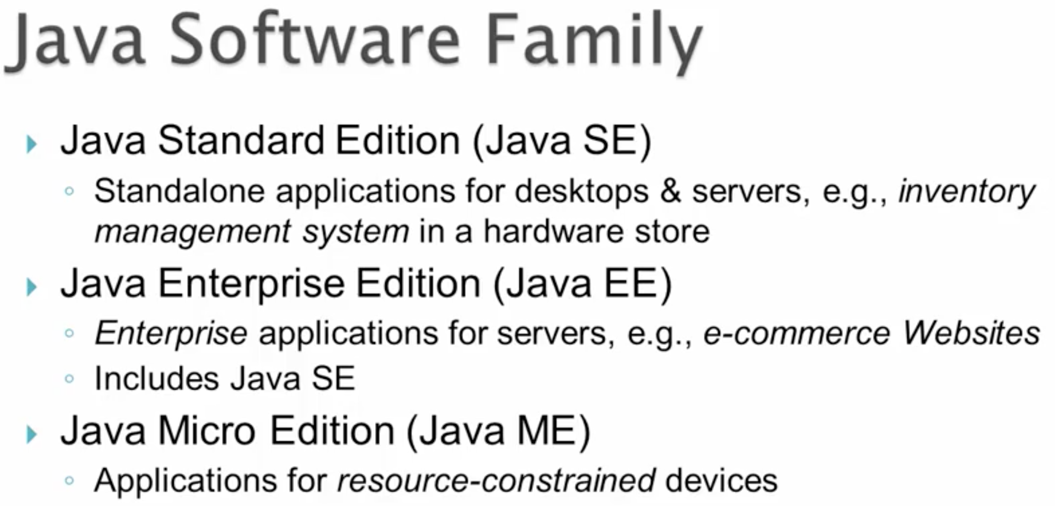

Slide 22
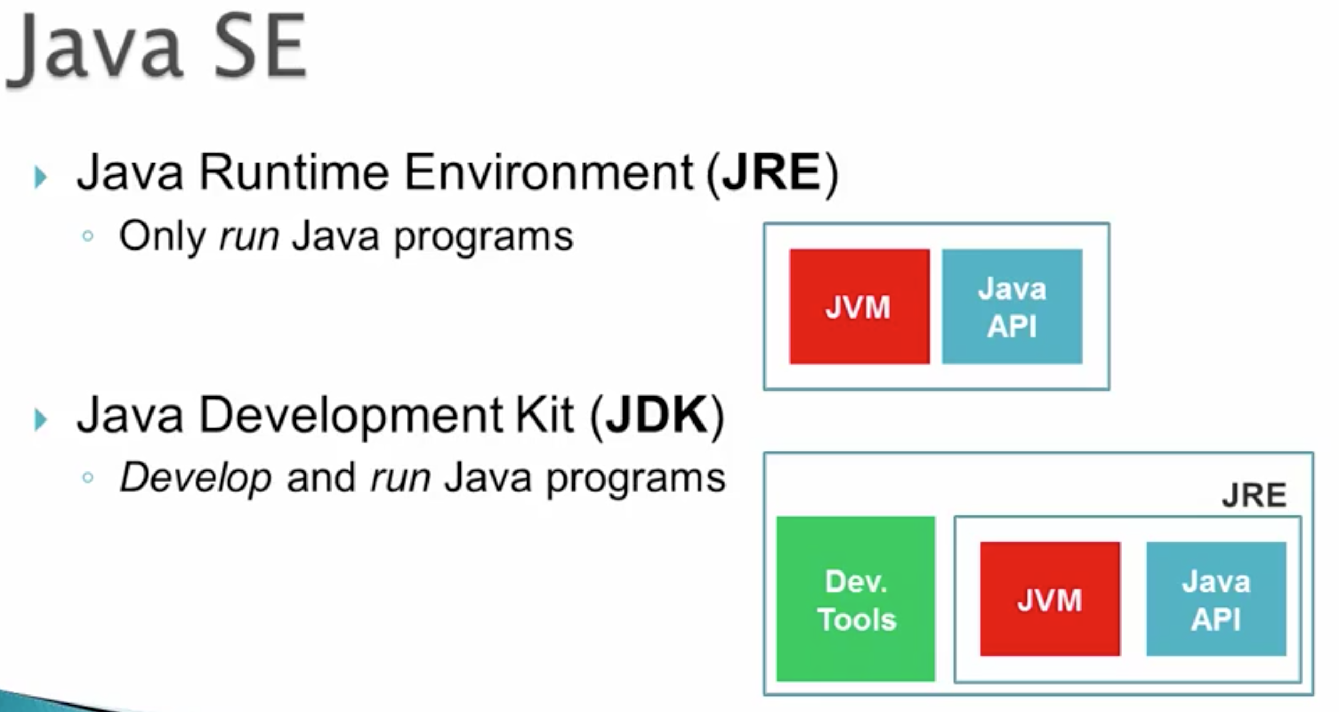


Slide 23
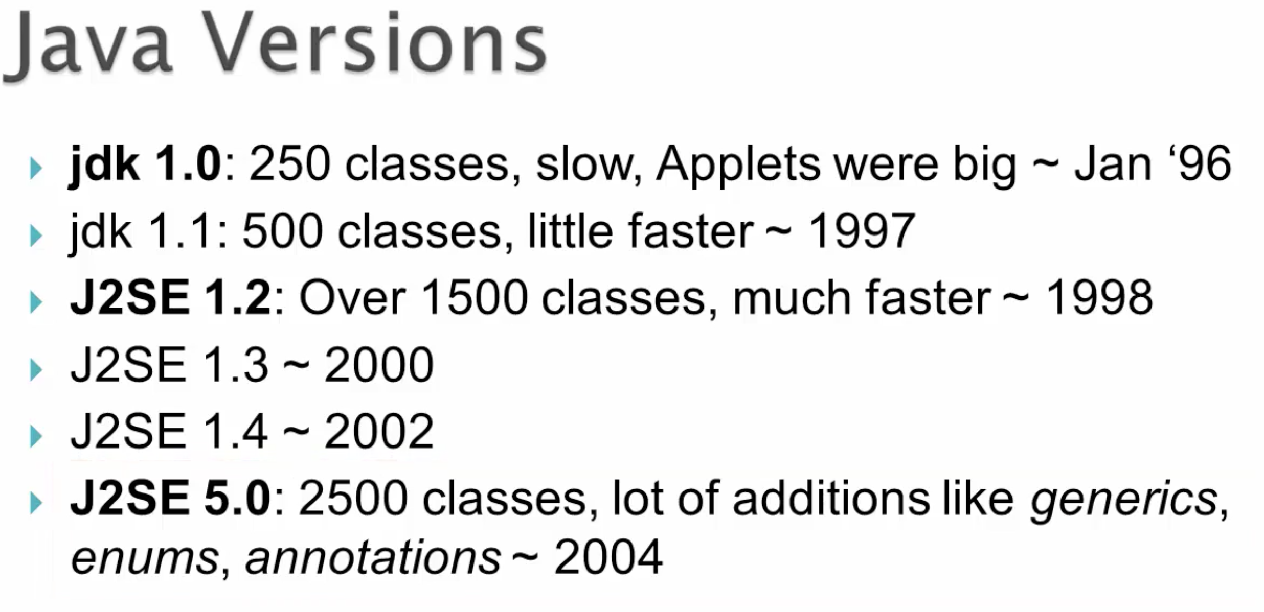

Slide 24
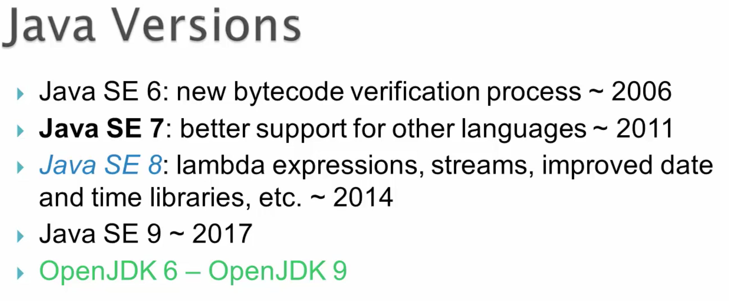

Slide 25
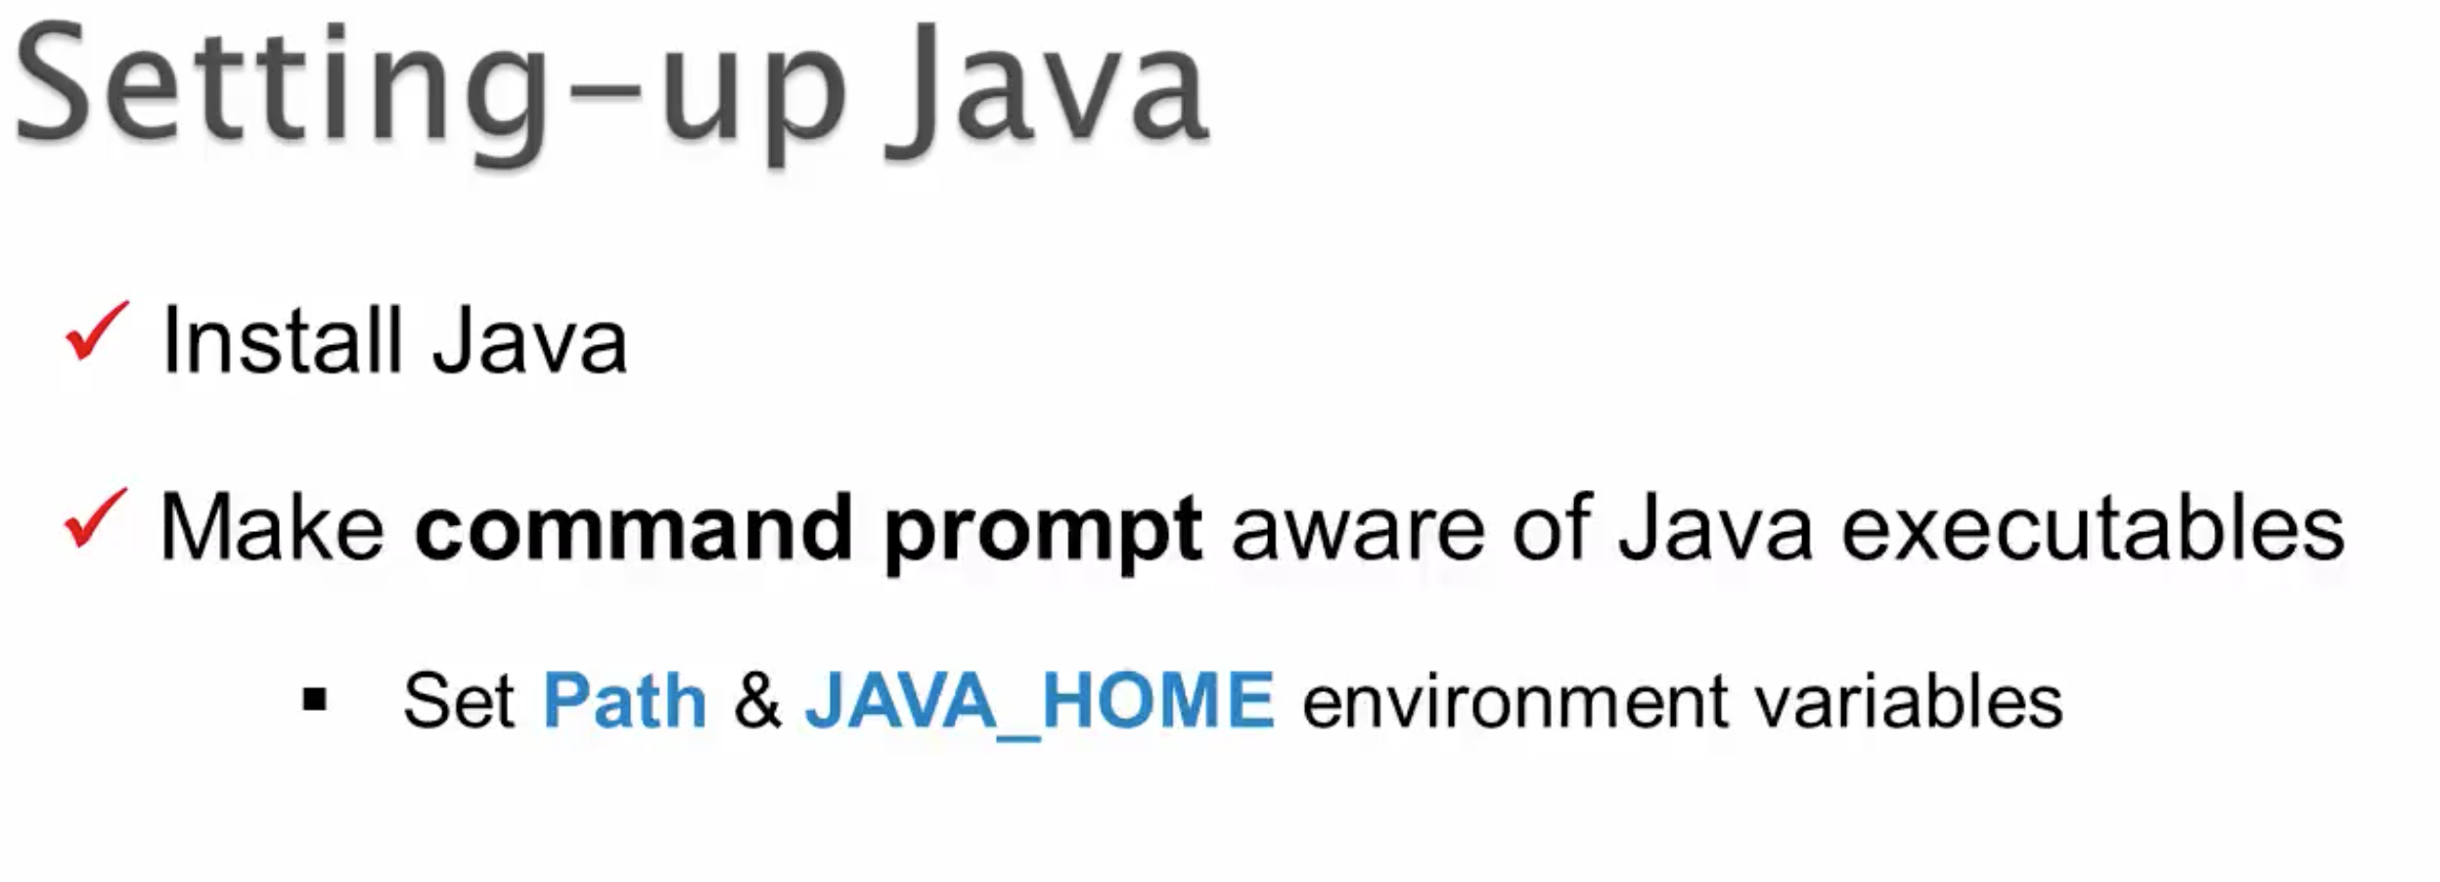

Slide 26
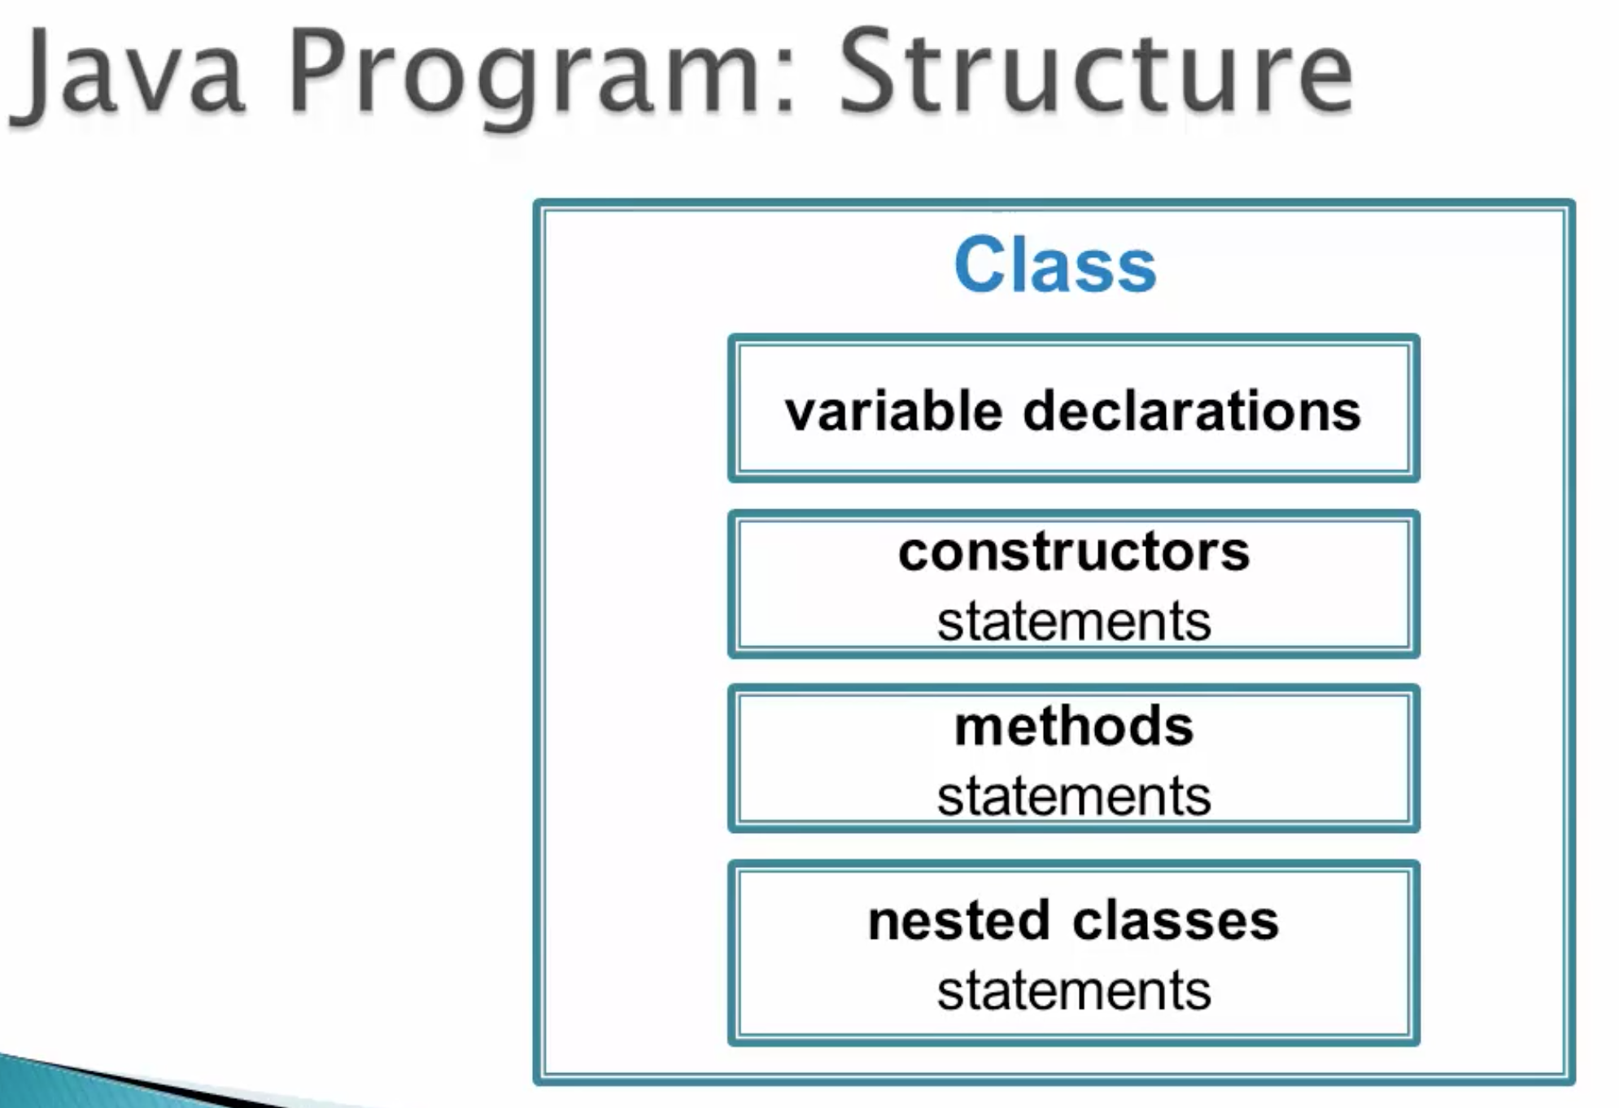


Slide 27
You can create the directory structure in root directory. Below are specific instructions on Windows and Linux.
Windows: - Open command prompt and go into C:\ drive.
Now, when you open command prompt, if the default directory path is not C:\ and is something else like say C:\dir1\dir2, then type cd.. to move into dir1 and one more cd.. to move into C:\ - In C:\ drive, type below instructions one after another.
mkdir is for creating a directory in the current directory while cd helps you to move into that directory:
mkdir javacourse
cd javacourse
mkdir src
cd src
mkdir com
cd com
mkdir training
cd training
mkdir basics
cd basics
Linux: Just run below command.
mkdir -p javacourse/src/com/training/basics && cd training/src/com/training/basics

Slide 28
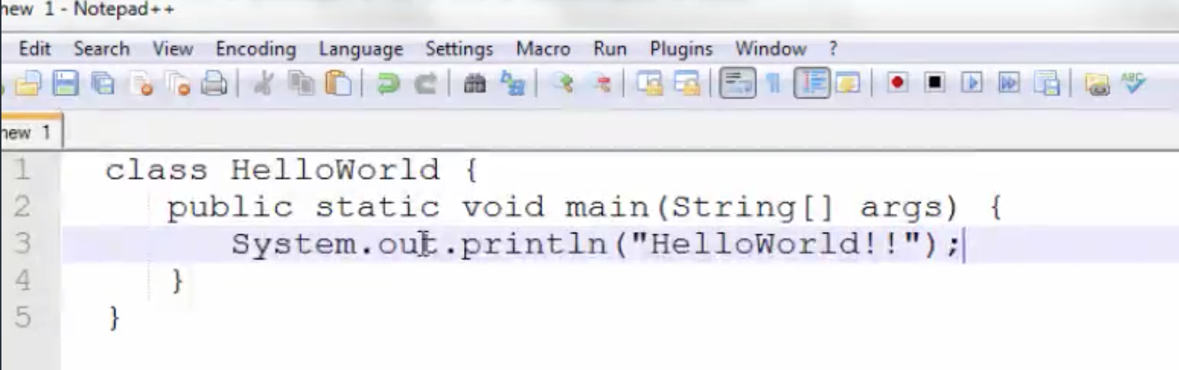

Slide 29
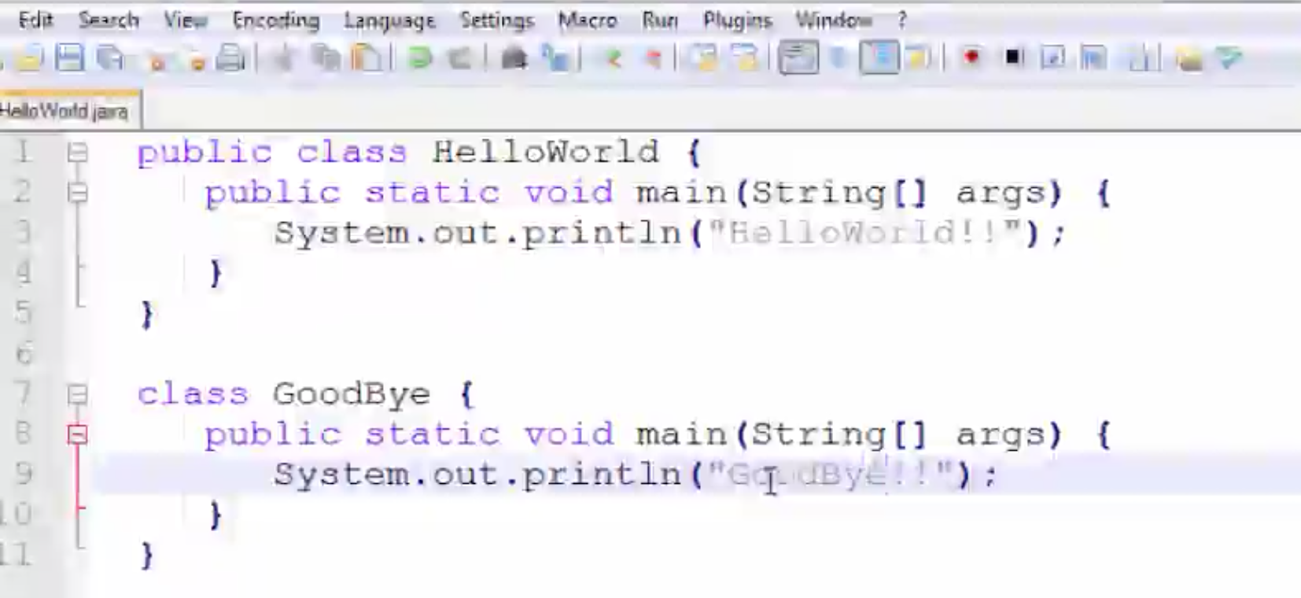

Slide 30
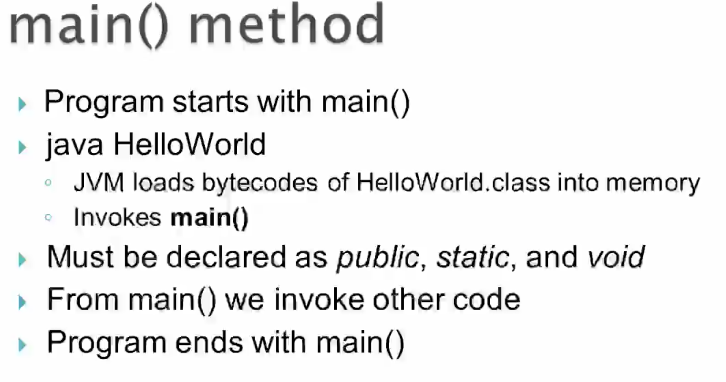

Slide 31
